Slide 1
DAH2F3 Perencanaan Sumber Daya Perusahaan
Minggu ke-10: Human Capital Management
P r o d i D 3 K o m p u t e r i s a s i A k u n t a n s i F I T , U n i v e r s i t a s T e l k o m

Slide 2
AGENDA
Lesson: Human Capital
Management
Overview
Recruitment
Reference:
SAP. (2006). SAP01: SAP Overview. SAP AG.
Personnel Management
Personnel Development
Appraisal
Training and Event Management
Time Management
Payroll
Personnel Cost Planning

Slide 3
Unit 6: Human Capital Management
Unit Overview
mySAP ERP HCM covers a broad list of function, including recruiting and hiring employees, determines benefits and compensation, processing payroll, and many other areas.
Unit Objectives
Outline the task associated within HCM
Explain how SAP within mySAP ERP HCM support the key process in HCM
Differentiate between SAP HR organization element and master data
Describe an organization plan and indentify its organizational elements

Slide 4
Unit 6: Human Capital Management
Unit Objectives (Cont)
Describe the Manager’s Desktop and the functions that drive a successful recruitment plan
Enter a new employee and establish key Master Data records for that employee
Describe how personnel time is managed and evaluated in the Human Resource Modul
Define how payroll is managed within an organization using the HR Component

Slide 5

Agenda
Lesson: Human Capital
Management
Overview
Recruitment
Personnel Management
Personnel Development
Appraisal
Training and Event Management
Time Management
Payroll
Personnel Cost Planning

Slide 6
HCM Lesson Overview
mySAP HCM
Maximize the value of employee
Align employee skill, activities, and incentives with business objectives and strategy.
Provide tools to manage, measure, and reward individual and team contribution.

Slide 7
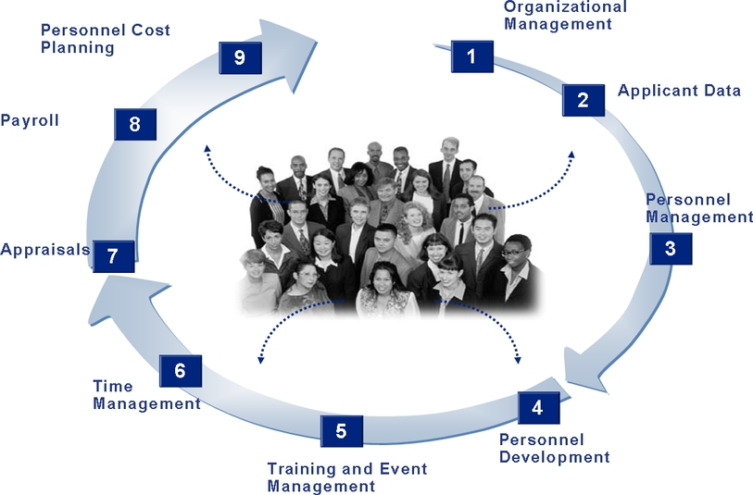
mySAP ERP Elements

Slide 8
mySAP HCM Organizational Elements
Client
Company Code
Organizational Unit (OU)
Organizational Unit
Company Code
Holding Company
Legal independent accounting unit
Various business unit. Eq. Functional and Regional
Position
Person
Smallest OU in organization structure
Position
Person
Organizational Unit

Slide 9
mySAP ERP Elements

Slide 10
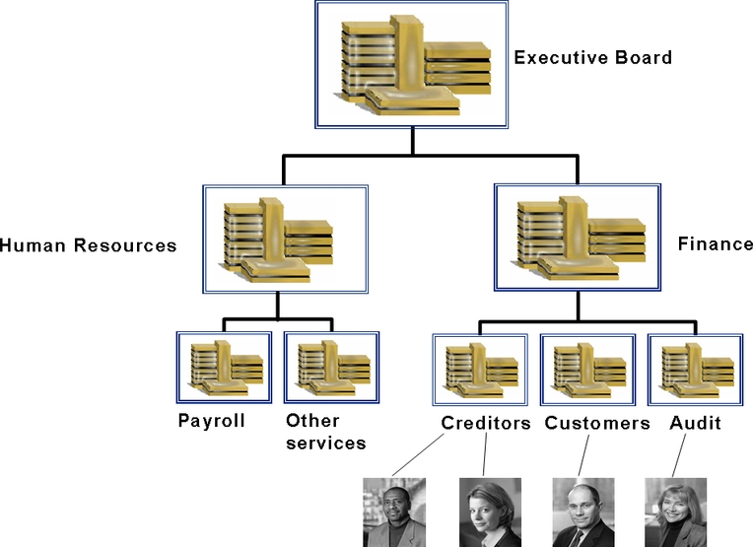
Organizational Management
Organizational
Unit
Position
Person

Slide 11
mySAP ERP HCM
Organization Element
Organizational Management
Client
Company Code
Organizational Unit
.
Position
Person
.
.
Organizational Unit
Jobs
Position
Person

Slide 12
mySAP ERP HCM - Component
Component
Recruitment
Personnel Development
Time and Event Management
Time Management

Slide 13
Agenda
Lesson: Human Capital
Management
Overview
Recruitment
Personnel Management
Personnel Development
Appraisal
Training and Event Management
Time Management
Payroll
Personnel Cost Planning

Slide 14
mySAP ERP Elements

Slide 15
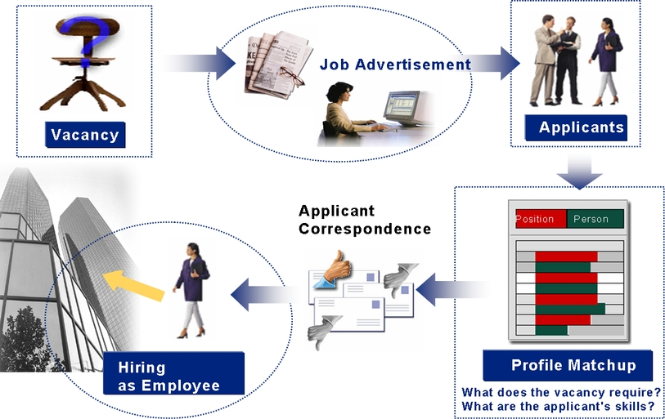
Recruitment Process
Notes:
Vacancy for new hire (external applicant) or changing position (internal employee).
Vacancy = position that need to be filled.

Slide 16
Recruitment Process
If Recruitment component integrated with Organization Management,
The vacant position are triggered if position is not assigned.
?
Notes:
Vacancy for new hire (external applicant) or changing position (internal employee).
Vacancy = position that need to be filled.

Slide 17
Recruitment Process
A typical process in Recruitment may involve the following steps:
The vacant position are published in the job advertisement
The applicants’ data is entered in the system
Automatically sent data to applicant

Slide 18
Recruitment Process
A typical process in Recruitment may involve the following steps:
A complex selection process takes place, culminating, in a decision being made
The employment contracts are generated for the applicants who are to be hired.
The applicant data is transferred to HCM master data

Slide 19
Recruitment Process
Profile match up
Position vs person
A typical process in Recruitment may involve the following steps:
A complex selection process takes place, culminating, in a decision being made
The employment contracts are generated for the applicants who are to be hired.
The applicant data is transferred to HCM master data
Applicant data in Recruitment → employee data in Personnel Administration
Next Discussion

Slide 20
Agenda
Lesson: Human Capital
Management
Overview
Recruitment
Personnel Management
Personnel Development
Training and Event Management
Time Management
Appraisal
Payroll
Personnel Cost Planning

Slide 21
mySAP ERP Elements

Slide 22
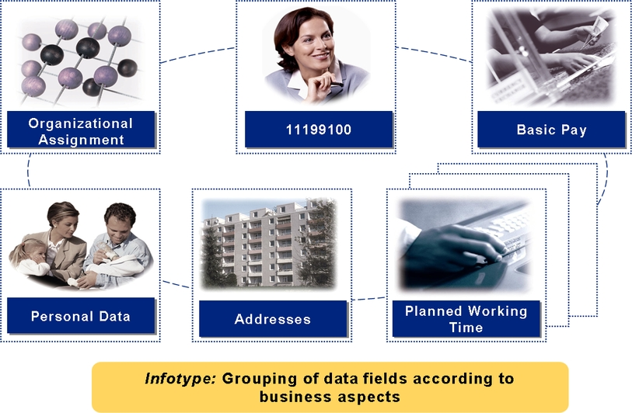
Personnel Management
Employee data is stored in mySAP ERP HCM as infotypes records.
Bank Detail
Notes:
New infotype for New Hire:
Organizational data assignment v
Personal Data v
Addresses v
Planned Working Time v
Basic Pay v
Bank Details

Slide 23
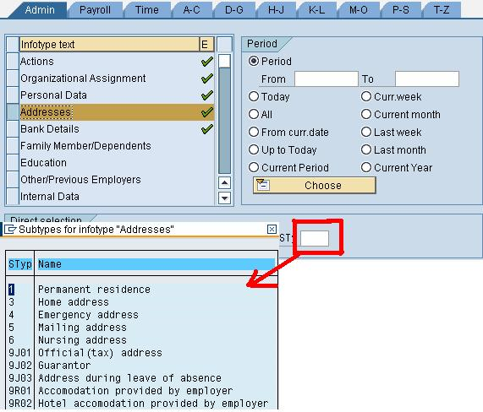
Infotype

Slide 24
Personnel Management
Various ways to maintain infotypes:
single-screen maintenance
(1 infotype – 1 person)
Personnel actions
(sequence of infotypes – 1 person)
Fast Entry
(1 infotypes – n persons)

Slide 25
Personnel Management
mySAP HCM Structure:

Slide 26
Agenda
Lesson: Human Capital
Management
Overview
Recruitment
Personnel Management
Personnel Development
Appraisal
Training and Event Management
Time Management
Payroll
Personnel Cost Planning

Slide 27
mySAP ERP Elements

Slide 28
Personnel Development
Component for
planning and realize employee development
Education and training

Slide 29
Personnel Development
SAP Component integration
Organizational Management
Recruitment
Personnel Development
Job Requirement
Employee Qualification
Requirement
Integration with
Training& Events Management
Planning&Execute course
Next Discussion

Slide 30
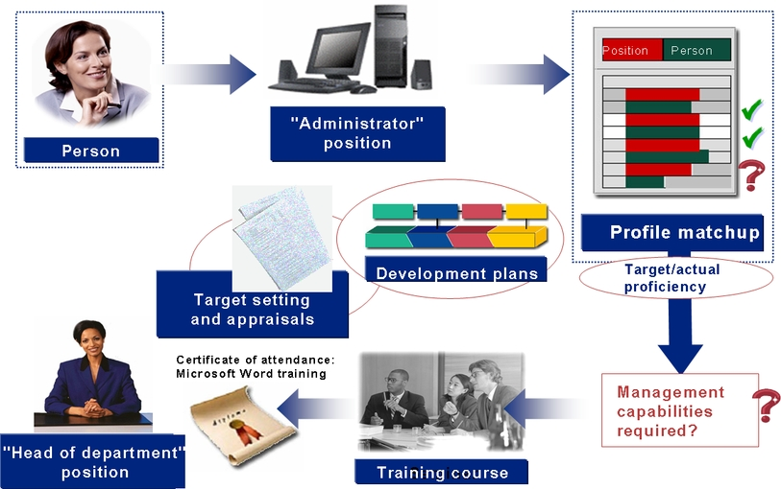
Personnel Development

Slide 31
Agenda
Lesson: Human Capital
Management
Overview
Recruitment
Personnel Management
Personnel Development
Appraisal
Training and Event Management
Time Management
Payroll
Personnel Cost Planning

Slide 32
mySAP ERP Elements

Slide 33
Training and Event Management
Component to support:
planning, execution, and managing training and courses and business event

Slide 34
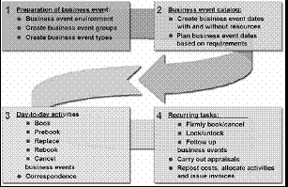
Training and Event Management
Preparation of business events:
Business events environment
Create business Events groups
Create business Events types
2. Business events catalogs:
Creates business event dates with & without resources
Plan business events dates based on requirement
After course happend
3. Day-to-day activities:
Book
Pre-book
Replace business events (BE)
Rebook
Cancel
4. Recurring Task:
Firmly book/cancel
Lock/unlock BE
Follow up
Carry out appraisal
Repost cost, allocate activities and issue invoice
Automatic Notification
Notes:
Preparation of business events → location
Business events catalogs → dates
Day-to-day activities → proses booking dan pelaksanaan
Recurring Task →

Slide 35
Training and Event Management
SAP Component integration
Personnel Development
Training& Events Management
SAP Leaning Solution
Need to develop
Planning&Execute course
Web-based training
Time Management
Next Discussion
Attendance List created
Notes:
Kotak biru adalah component

Slide 36
Training and Event Management
SAP Component integration
Personnel Development
Training& Events Management
SAP Leaning Solution
Need to develop
Planning&Execute course
Web-based training
Training & Events Management has
dynamics menus.
Which enables to access individual functions of the application directly via object in business catalog
Notes:
Kotak biru adalah component

Slide 37
Agenda
Lesson: Human Capital
Management
Overview
Recruitment
Personnel Management
Personnel Development
Appraisal
Training and Event Management
Time Management
Payroll
Personnel Cost Planning

Slide 38
mySAP ERP Elements

Slide 39

Time Management

Slide 40
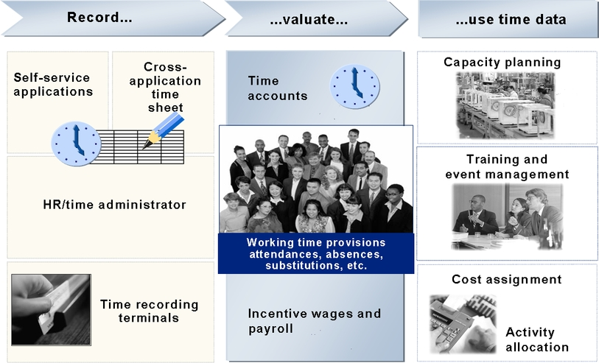
Time Management
How to record attendance/vacation/off site work/ substitution?
4
3
1
2

Slide 41
Time Management
Planned working time infotypes is stored as master data.

Slide 42
Agenda
Lesson: Human Capital
Management
Overview
Recruitment
Personnel Management
Personnel Development
Appraisal
Training and Event Management
Time Management
Payroll
Personnel Cost Planning

Slide 43
mySAP ERP Elements

Slide 44
Appraisal
To carry out standardized appraisals with highest level of objectivity.
What are appraised?
employee
business event
employee survey
customer survey
Notes:
Mengukur keberhasilan orang atau kegiatan

Slide 45
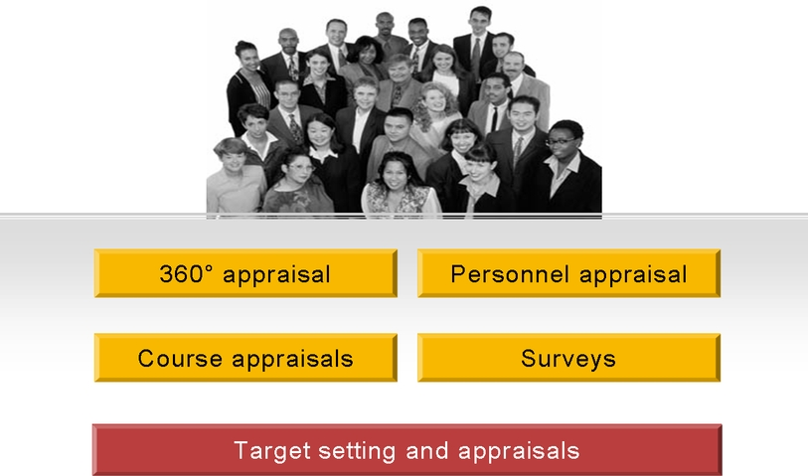
Appraisal
Notes:
360 degree : menilai diri sendiri
Personnel Appraisal : menilai orang lain
Course Appraisal : After attending course
Survey : based on management survey

Slide 46
SAP Component integrate to Appraisal
Appraisal
mySAP ERP HCM Personnel Dev
SAP SEM
Compensation Management
SAP BW
Display
department goals
Adopt default
compensation adjustment
Compile special analysis of
the appraisal results
Transfer requirement profile
From position/qualification
catalog
Notes:
SAP SEM = Strategic Enterprise Management
SAP BW = Business Information Ware House

Slide 47
Agenda
Lesson: Human Capital
Management
Overview
Recruitment
Personnel Management
Personnel Development
Appraisal
Training and Event Management
Time Management
Payroll
Personnel Cost Planning

Slide 48
Payroll
Calculating each employee’s remuneration for the work whose had performed.

Slide 49
mySAP ERP Elements

Slide 50
Payroll
Steps to calculate employee’s remuneration:
1. Grouping the remuneration element (Gross Payroll
2. Legal and voluntary deduction (country specific net payroll)

Slide 51
Agenda
Lesson: Human Capital
Management
Overview
Recruitment
Personnel Management
Personnel Development
Appraisal
Training and Event Management
Time Management
Payroll
Personnel Cost Planning

Slide 52
mySAP ERP Elements

Slide 53
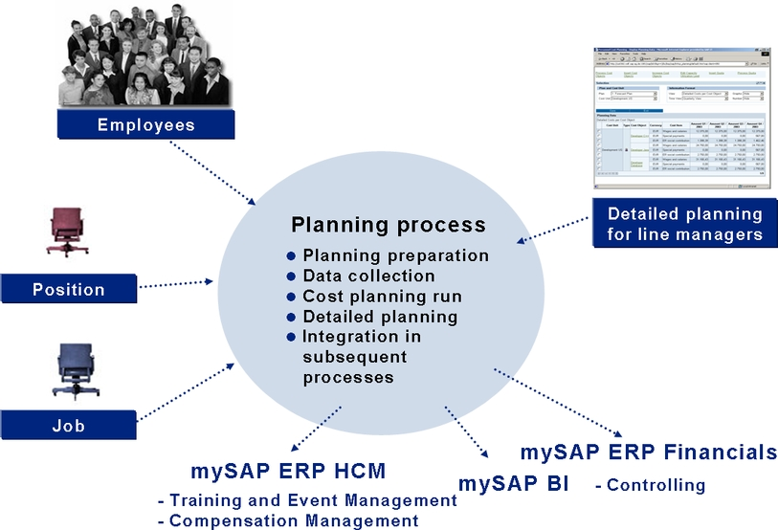
Personnel Cost Planning

Slide 54

End of This Session

